Slide 1
Searching the Internet
GST 105 – IT and Library Skills
Instructor –

Slide 2
INTRODUCTION
Due to the number of sources of information and ambiguity of language, searching for a precise information on the internet is quite cumbersome and time consuming.
Search engines are used for searching through content of webpages, it returns large amount of result from search, which not all might be relevant to the search query.
Hence the need for effective search skills.

Slide 3
Objectives
At the end of this class, a student should be able to do the following:
Familiar with difference search engines
Formulate an efficient search query
Use search operators
Use modifiers
Filter search result
Use advance search

Slide 4
What is a search engine
Software usually online (on the internet)
Finds information based on users' queries
Queries are information (text, image or sound) to aid search
Example of search engines
Google (70% of search)
Bing (Microsoft)
Baidu (china)
Yahoo
Ask.com

Slide 5
Classification of Search Engines
Crawler Based Search Engines: Uses a “Spider” or a “crawler” to search the internet and then adds the pages to the search engine’s database. E.g., Google and Yahoo
Directories: these are human powered search engine; website is submitted to the directory and must be approved for inclusion by editorial staff. E.g., Internet Public Library.
Hybrid: a mix of crawlers and directories, option of which to go with might be provide, human results are listed first by default.
Meta Search Engines: searches several other search engines at once and combines the results into one list. E.g. Dogpile and Clusty.

Slide 6
Basic Search Technique
Understand what you are searching for.
Question, topic …etc
Keep the search key simple
Consider synonyms
Various spelling
American vs British spelling
Acronyms
Use few words to describe what you want.

Slide 7
Basic Search facts
Case insensitivity
Ten is TEN
Search operators are case sensitive
Stop words are avoided in searching
Such as: on, of, the, a.
Search use other keywords to match with words on web pages.

Slide 8
Better your search
Use fewer terms for search query.
The more terms you use the wider the variation of result you get.
Use operators
Use modifiers

Slide 9
Google Search Operators
Phrase Search “ ”: enforces the search of exact words and the order defined between the quotes
* or wildcard operator: treat that position as a place holder for an unknown term(s)
Nile * Nigeria: Possible results : Nile university of Nigeria, Nile people and culture of Nigeria
~ Tilde Operator: search for what you specified in your query and any perceived similar term/keyword by Google.
E.g.: sitting styles~

Slide 10
Google Search Operators
Boolean Operators
Information search in most databases is based on Boolean logic (logical relationship between key words
AND operator (+)
Narrows search by focusing on a specific combination
Eg: searching for cars AND 2021: only results with both feature are presented
Or Operator:
Broadens the search to accommodate all search terms
Eg: card OR red: any card and any red
Not (-): reduces search space

Slide 11
Google Search Operators
Advanced Search Operators:
They are researched keywords that have special meaning to google.
They are used to modify search in certain ways
They can be used to define the type of search google should do
Allinurl: restrict search results to only those pages with the search query specified in the URL.
Allintitle: limits search results to only pages that have the specific keyword in the webpage’s title. E.g. allintitle: tesla vs edition
Intext: search for a word or phrase (in quotes), but only in the body/document text.
Filetype: Match only a specific file type. E.g. “tesla announcements” filetype:pdf
Related: returns sites that are related to a target domain. Only work for large domains e.g. related:nytimes.com

Slide 12
Search Result
Color code for different search results
Page title : blue
URL: Green
Page content: Black

Slide 13
Search Result type
Various tabs to define the type of content on result
All: combines everything
Images: Image results
Videos
Statistics
News
Maps

Slide 14
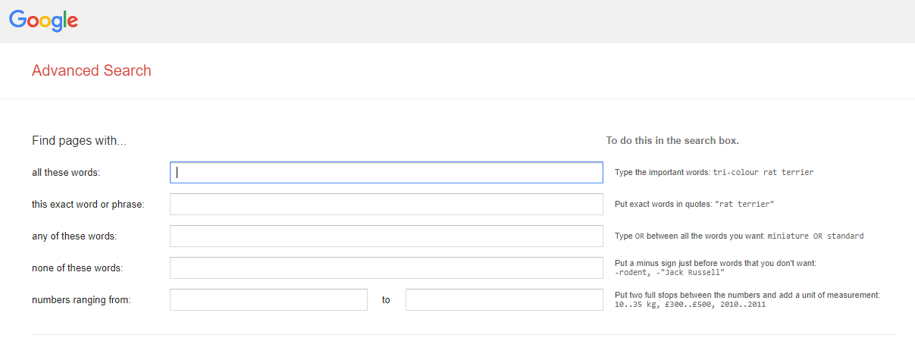
Google Advanced Search

Slide 15
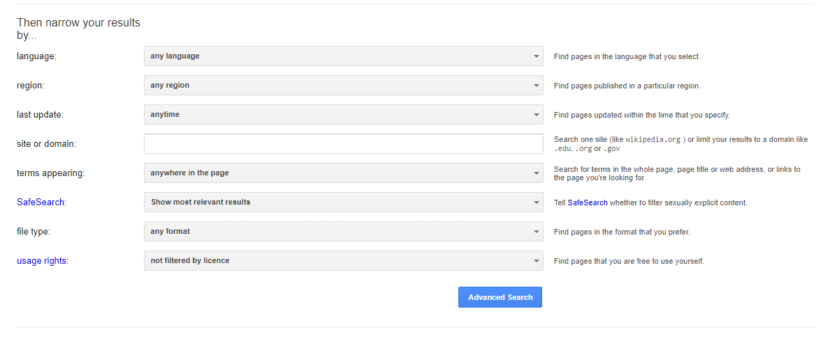
Google Advanced Search

Slide 16
Other Google Services
Google Scholar: scholar.google.com
Google lens
Google classroom
Blogger
Youtube
Drive
Calender
Maps
Translate
Chrome
Android
Google play
…etc.
For more go to
https://about.google/products/

